Slide 1


Grants Management
Certification
2018

Slide 2
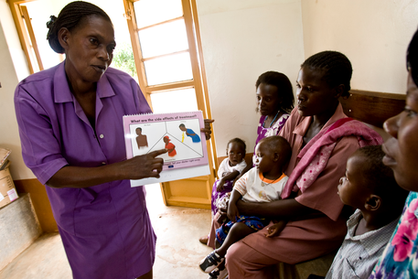
Agenda
Sustainable Impact
Partnership
Planning
Applying
Implement, Monitor and Evaluate
Reporting
Support

Slide 3
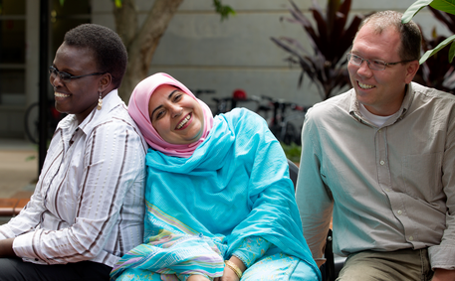
Global Grant Requirements
Your project must:
  Have a long-term, sustainable impact
  Clearly fit into one of Rotary’s areas of focus
  Invest at least $30,000
  Address a need identified by the community
  Strengthen the community’s capacity to meet its own needs

Slide 4

Global Grant Requirements
You must:
  Apply through Rotary.org
  Actively involve the benefitting community
  Partner with a club in another country
  Develop a project plan that includes a budget and a financial management plan
  Measure progress toward the outcome
  Stay up-to-date in reporting for all active grants

Slide 5
Eligible Activities
Humanitarian Projects
  Sustainable, measurable outcomes that address real community needs
Vocational Training
  Build skills trough targeted educational programs
  Vocational Training Teams
Scholarships
  Fund International graduate-level study within a Rotary focus-area

Slide 6
Club Qualification
Attend a Grant Management Seminar
Complete the Club Memorandum of Understanding (MOU)
Club Donation to TRF by June 15, 2018, including Annual Fund, Polio Plus, approved Foundation Grants, Endowment (Permanent) Fund
Submit Club Goals through Rotary Central for 2018-2019 by June 15, 2018

Slide 7

Sustainability
Start with the community
  Identify a need and a solution that builds community strengths and aligns with local values
Encourage local ownership
  Identify key community members who can pioneer lasting improvements
Provide Training
  Strengthens ability to meet objectives

Slide 8
Sustainability
Buy Local
  Builds capacity and ensures spare parts remain available
Find local funding
  Funding from local government, hospitals, companies
Measure success
  Start with base line data, measurable outcomes and sound collection practices

Slide 9
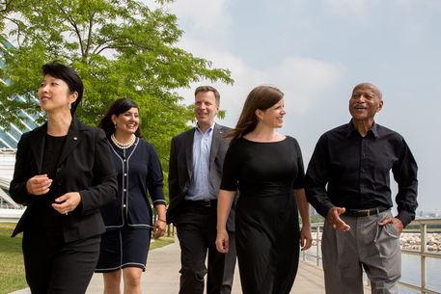
Making an Impact: The Areas of Focus
Promoting Peace
Fighting Disease
Providing Clean Water
Saving Mothers and Children
Supporting Education
Growing Local Economies

Slide 10
Making an Impact
Consider setting a high-level goal
Think about the impact, not the activity
Read Rotary’s Areas of Focus Guide/Policy Statements
  - Rotary’s Goals
  - Eligible Activities
  - Elements for Successful Grants

Slide 11
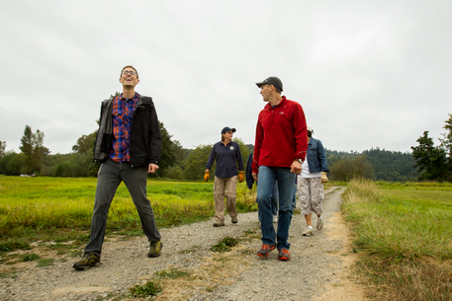
Community Assessment
Rotary asks the local club(s) to do an assessment
  Project is driven by data from the start
  Lends credibility
  Determines sustainability
  Should involve different groups
  Determines feasibility, the clubs’ qualification, and determines if another organization is already meeting the need

Slide 12
Partnership Requirements
Host Sponsor
  Initiates the Project
  Community Assessment
  Manages Implementation & Budget
  Receives Project Funds
International Sponsor
  Financial Assistance
  Technical Support
  Performs tasks that can be done remotely
  Participates in service during site visits

Slide 13
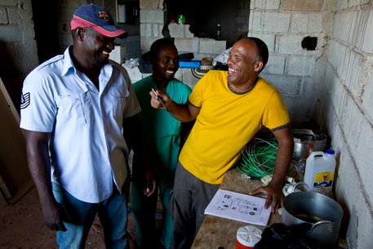
Partnership Requirements
Both Sponsors
  Must be qualified
  Develop the project plan
  Have project committees that collaborate/communicate
  Partner with cooperating organization, if needed

Slide 14
Develop a Project Plan
The plan should document
  Impact
  Measurable goals and outcomes
  Actions needed for each step
  Assignment of responsibilities
  Monitoring and data collection
  Possible alternatives if things aren’t going to plan

Slide 15
Develop a Project Plan
Create a Timeline that includes
  Community Assessment
  Committee Meetings
  Training
  Meetings with Community and Cooperating Organizations
  Project Implementation Milestones
  Monitoring
  Evaluation – middle and end

Slide 16

Other Tips
Work as a Team
  Sponsors each need a committee of at least three
Plan for Continuity
  Who’s in for the long haul?
Who will do what?
  Down to last detail
Avoid Conflicts of Interest
  No one with a financial interest

Slide 17
Other Tips
Get Expert Advice
  Qualified club members
  Cooperating Organizations
  Rotarian Action Group (RAG)
  Cadre of Technical Advisors

Slide 18
Measurable Outcomes
Be specific about who will benefit and what benefits they will receive
Establish baseline data and set benchmarks
Specify your measurement methods
Create a timeline
Budget 5% to 10% of your project funds to cover evaluation

Slide 19


Financial Management Plan
Promotes Oversight and Transparency; and Reduces Errors and Misuse
  Proper distribution
  Thorough financial records
  Manage a club or district controlled bank account
  Note: Host and International Partner a are responsible

Slide 20

Budget
Take into account
  Project goals
  Fundraising resources
  How much DDF is available?
Must be detailed, line item
Three competitive bids … best price & best quality
  Identify involved Rotarians – can’t be on a committee
  Document the reason for your vendor selection

Slide 21

Raise Funds
Global Grants are a combination of
  Club Funds
  District Funds and
  TRF’s World Fund of at least $15,000

Slide 22

Raise Funds
District Designated Funds are matched 100% by the World Fund
Rotary Member Cash Contributions (or funds raised by Rotary members) are matched at 50% by the World Fund
Nonmember Cash Contributions to the project account or to TRF are eligible to be matched at 50%; not from cooperating organizations or beneficiaries
  Note cash contributions to TRF require an additional 5%

Slide 23
Funding Example
Host contributes $4,000
International Sponsor contributes $6,000
Districts use DDF of $10,000
The World Fund matches the clubs at $5,000 and the DDF at $10,000, for a total of $15,000
Total raised: $35,000

Slide 24

Points to Remember
TRF never asks for funding from the benefitting community – we don’t ask for money in exchange for grants
However, a community account can be encouraged to address post-grant related costs (e.g. repairs)

Slide 25
Getting Started
Call or email DG or DRFC (John Chase or Susan Johnson) to discuss available DDF
Use the online Grant Application Tool on My Rotary
Applications are accepted year-round
Give yourself plenty of time to complete, especially grants involving international travel

Slide 26

The Application
When you start there’ll be a knowledge check to see if the project meets global grant requirements
Then you’ll be asked to describe
  Objectives
  Activities
  Plan and schedule
  Community Needs
  Area(s) of Focus
  Partners
  Budget and Financing

Slide 27

Then What?
Once the application is complete
  Regional Grants Officer reviews
  If World Fund match is $50,000 or more, it is reviewed by the Cadre of Technical Advisors
  DDF authorization by the DG and DRFC
  Application is authorized by
    Primary Club Contacts
    Club Presidents
    DRFC and DG

Slide 28
Why Grants Get Denied
Doesn’t fit an area of focus
Isn’t sustainable
Benefits another organization’s programs
A club partner has reached 10 open grants
A club partner isn’t current on reporting on other grants

Slide 29

Points to Remember
Begin the application only after your club and partners have finalized the project plan (and you’ve contacted the DG or DRFC about funding)
Be clear and concise in your answers
Your regional grants officer is there to help you succeed

Slide 30
Implementation
Communicate regularly with community and partners
Review
Revise and get changes approved
Measure
Check in
Update your members and partners about progress, challenges and solutions throughout

Slide 31
Monitoring and Evaluation
A continual process of collecting specific data
Uses your measures and benchmarks
Assesses how well you are meeting the stated objectives
Helps you understand how to improve over the short and long term
It’s done from start to finish

Slide 32


Financial Transparency
Follow the financial management plan
  Keeps track of funds
  Promotes transparency
  Safeguards against misuse
  Facilitates reporting
  Is a guide for record keeping

Slide 33
Other Tips to Remember
The Bank Account
  Club-controlled and only for receiving and disbursing funds
  Not for investment
  Account name should identify the club and require two signatures for checks
Follow Local Laws
Sign a Global Grant Legal Agreement
Unused money gets returned to Rotary
Keep financial records and other documents

Slide 34
Rotary is Watching
The project may
  Undergo a Technical Review during the application period
  Have a Site Visit
    Before, during or after
  Audit
    Can be on-site
    Done randomly

Slide 35
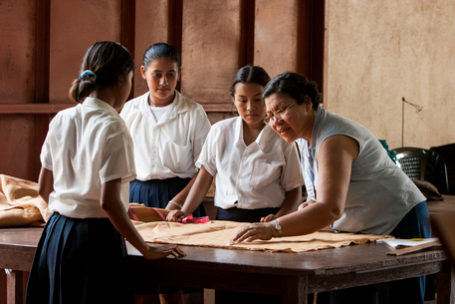

Reporting Requirements
Both the host and international sponsors are responsible for reporting
First report is due within 12 months of receiving the first grant payment and every 12 months thereafter
Last report is due within two months of completion

Slide 36


Why bother?
Reporting shows good stewardship
It demonstrates to the world what Rotary is accomplishing

Slide 37
You are Not on Your Own
District Foundation Committee
Regional Rotary Foundation Coordinator
Regional Grants Officer
Area of Focus Managers
Cadre of Technical Advisors
Rotary Support Center
Rotary Grants Discussion Group
Rotary Ideas
RI Convention

Slide 38
Questions?
Susan Johnson
District 5300 Foundation Chair (2018-2021)
(702) 671-0547 (work)
(702) 496-7302 (cellular)
Loshj-ej@msn.com

