Slide 1
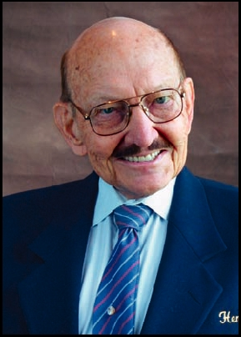
George R. Hensel Ethics Contest
1924-2012

Slide 2
Purpose
The main purpose of this contest is to promote the importance of ethics among today’s youth and to encourage them to express their views

Slide 3
Unique to District 5300
Fully endowed by Rotarian George Hensel
No costs to individual clubs
Cash prizes to students each year
Modest responsibilities for Vocational Avenue of Service at each club

Slide 4
District Level Awards
First Place Winner Receives $3,000
3 Runners-Up Receive $500 each

Slide 5
Who Can Participate?
The contest is open to all high school students from grades 9 – 12 (on March 31)
Living in or enrolled in any public or private high school in the geographic boundaries of district 5300

Slide 6
Why Participate?
Recognize local students
Highlight Rotary’s commitment to youth
It’s a program members and guests will enjoy
to highlight Rotary's commitment to the youth o

Slide 7
Lots of Work?
Locate your local schools
Talk to the college counselor, principal, or English Department Chairperson
Outline the specific dates and requirements
Judge the Club level essays

Slide 8
Judging?
3 judges per 10 essays is optimal
Invite school personnel, elected officials, friends of the Club to judge, potential members

Slide 9
Are There Rules?
500-1,000 words
12 point standard font
Original, unpublished work
Must be submitted by the Club via email or U.S. mail
The essay may not be submitted to another club

Slide 10
What’s the Judging Criteria?
Content = 40%
Clarity of message
Presentation
Creativity = 40%
Style
Originality
Composition = 20%
Grammar
Spelling
Structure

Slide 11
Time Line?
Submit to the Club by February 27
Submit to the District by March 31

Slide 12
Winners Awarded at District Conference!

Slide 13
Could it be that simple?

Slide 14
Everything you need
District5300.org has information that can be passed out to school officials and students that explain the contest!

Slide 16
Everything you need
District5300.org also has the forms you need to keep track of local contestants’ entries.

Slide 18
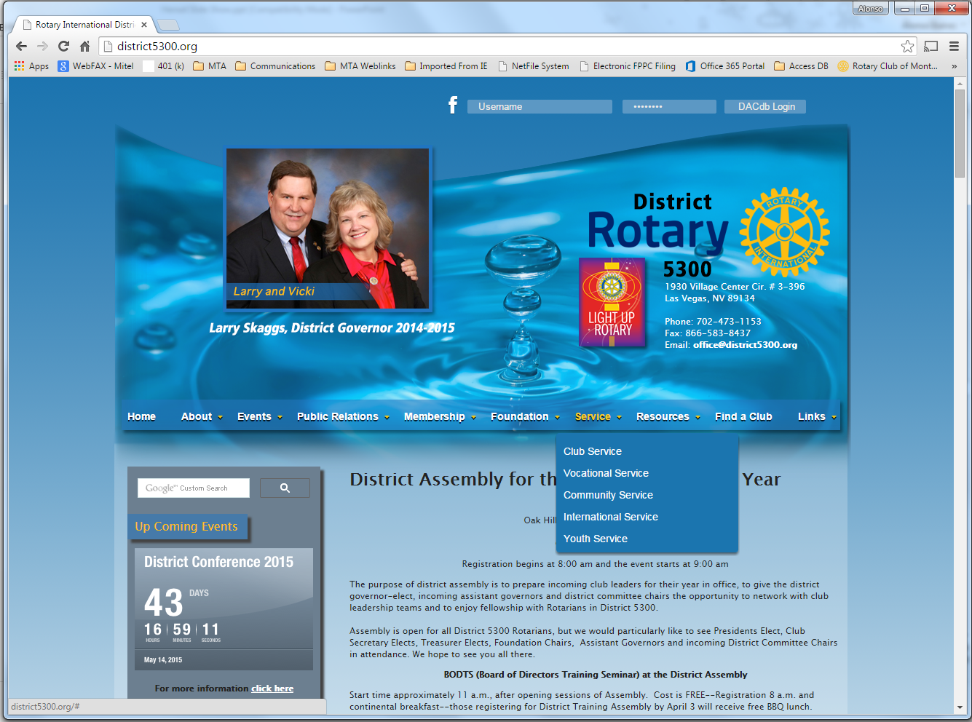

Slide 19
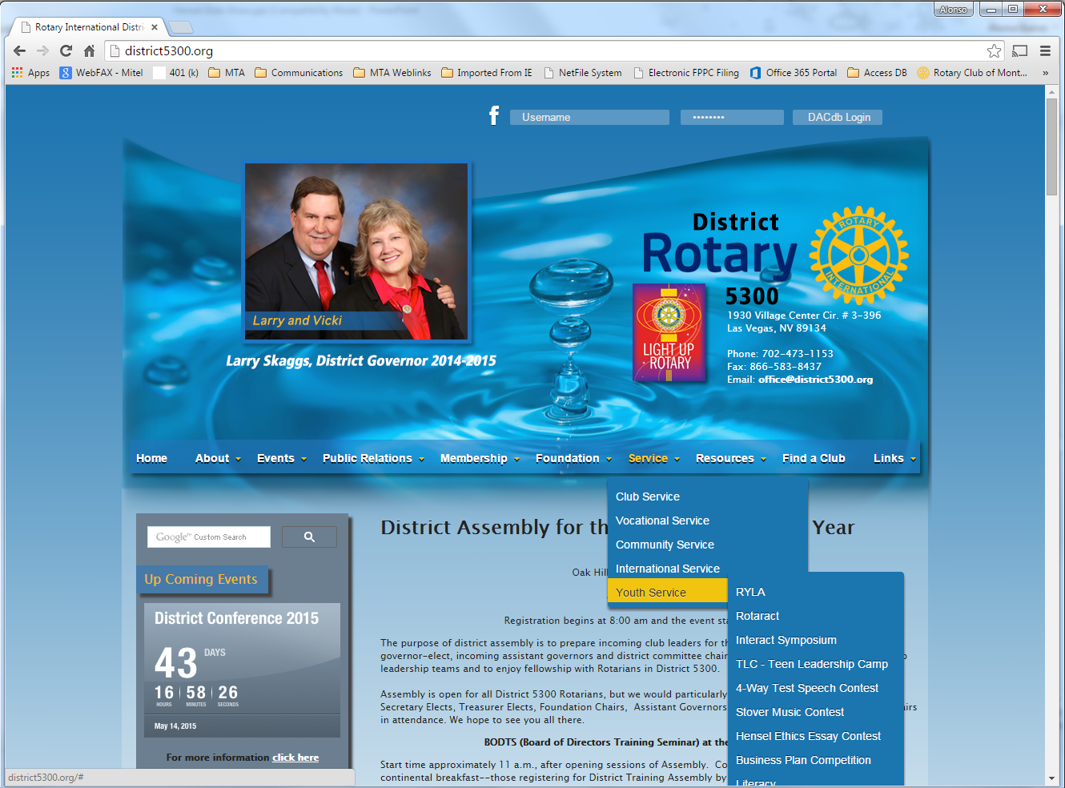

Slide 20
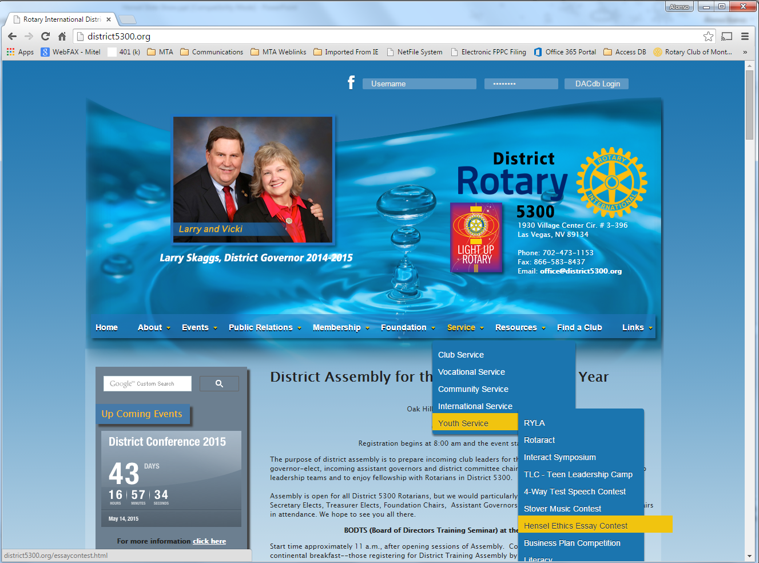

Slide 21
Everything you need
District5300.org also has the forms you need submit your local contest winner to the District contest too!

Slide 22
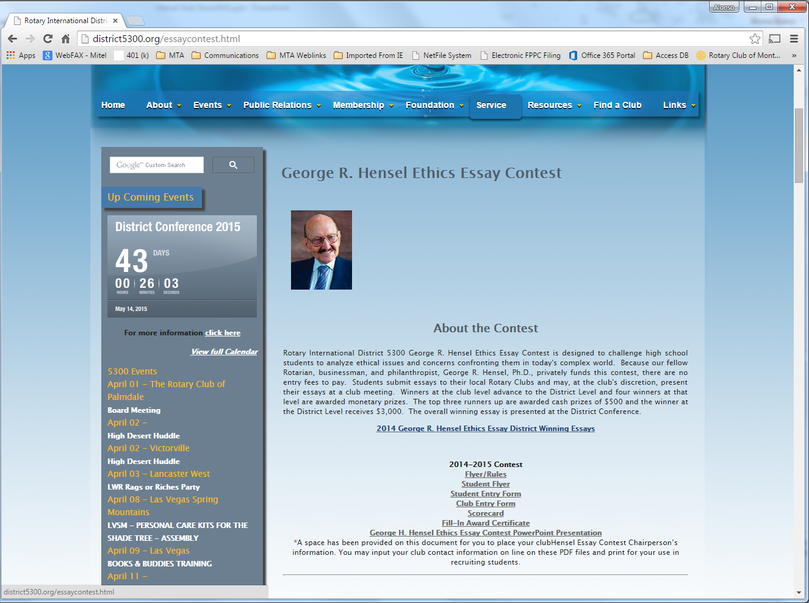

Slide 23
Everything you need
There is even a Score Card that automatically adds up scores for you.
Your judges can simply download the form, fill it out and send it back!

Slide 25
Everything you need
Even recognizing your local winner is easy.
All you have to do is fill out and print the already available GRH Award Certificate!

Slide 27
Everything you need
District Level Winners and Runners Up are uploaded to the site for the world to see.

Slide 29
What if I forget how?
That’s easy… this entire PowerPoint Presentation is available for download on the site as well.

Slide 31
Rotarian George Hensel wants this contest to be user friendly and without costs for Clubs

Slide 32
George Shows Us Service Above Self
Promoting the importance of ethics
Creating a venue for high school students to express their views
Giving recognition to outstanding writing skills
Giving Rotary a higher visibility within your community

Slide 33
We Can
Run a contest in each of our Clubs
Budget for local awards and certificates (optional and recommended)
Make the Contest a PR moment for our Clubs

